Slide 1


Image quality assessment across viewing distances: A comparison study of CSF-based and rescaling-based metrics
HVEI 2024
Visual Quality Across Displays and Viewing Conditions
Dounia Hammou¹, Lukáš Krasula², Christos G. Bampis², Zhi Li², Rafał K. Mantiuk¹
¹ University of Cambridge, UK
² Netflix Inc., US

Slide 2
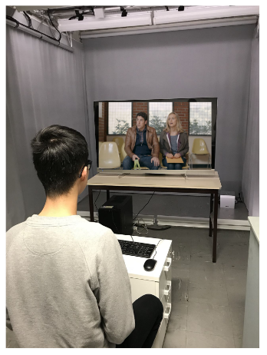
Quality assessment metrics’ assumption
Most quality assessment metrics, such as PSNR and SSIM predict the same quality for all users without taking into consideration their viewing and display conditions.

Slide 3




Quality assessment metrics’ assumption
However, the display and viewing conditions differ substantially between the users, and such differences can substantially affect the perceived quality.

Slide 4

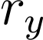
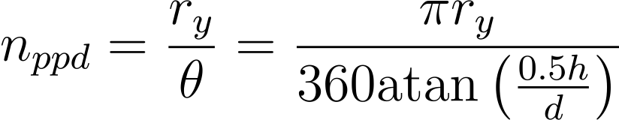
Effective Resolution
Vertical
Resolution
Viewing Distance
Effective Resolution [pixels per visual degree (ppd)]

Slide 5
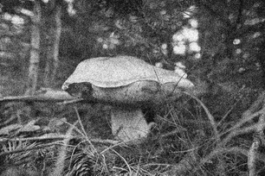


Effective Resolution and Perceptual Quality
The human visual system is less sensitive to contrast at higher effective resolutions.
The visibility of distortions decreases with the increase of effective resolution.
30 ppd
60 ppd
90 ppd

Slide 6
02
Quality assessment metrics for varying effective resolutions

Slide 7
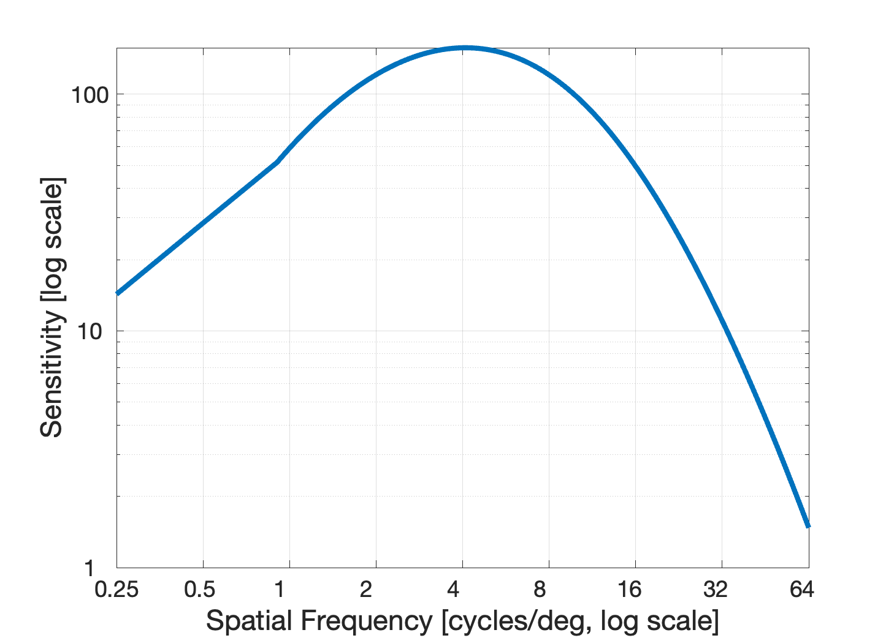
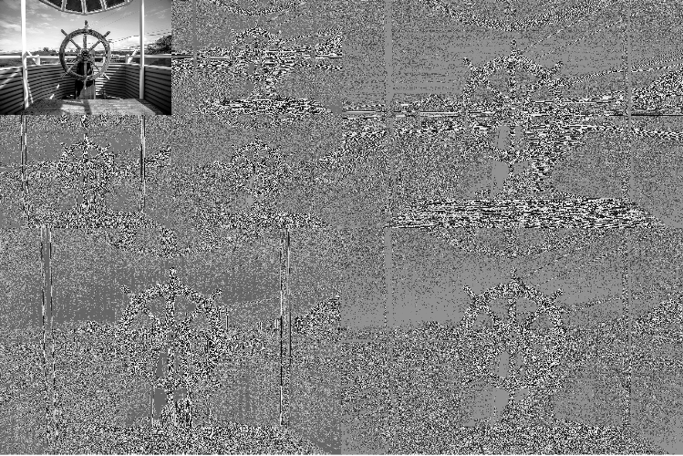

Contrast Sensitivity Function (CSF)
CSF
Wavelet Transform
Laplacian Pyramid
Fourier Transform
Mantiuk, Rafał K., Maliha Ashraf, and Alexandre Chapiro. "stelaCSF: a unified model of contrast sensitivity as the function of spatio-temporal frequency, eccentricity, luminance and area." ACM Transactions on Graphics (TOG) 41.4 (2022): 1-16.

Slide 8
Rescaling Function
Effective Resolution
Because the effective resolution is the resolution projected on the retina.
We can imitate the effect of effective resolution by altering the image resolution.
Vertical
Resolution
Display Height
Viewing Distance

Slide 9
The differences between the two types of metrics
Our recent study conducted on 4 publicly available datasets showed no statistical difference between the two types of metrics.
The motivation behind this work:
Understanding the similarities and differences between the two approaches.

Slide 10
03
Comparison analysis
Comparison analysis of CSFs-based and rescaling-based quality metrics

Slide 11
CSF-based quality metrics

Slide 12
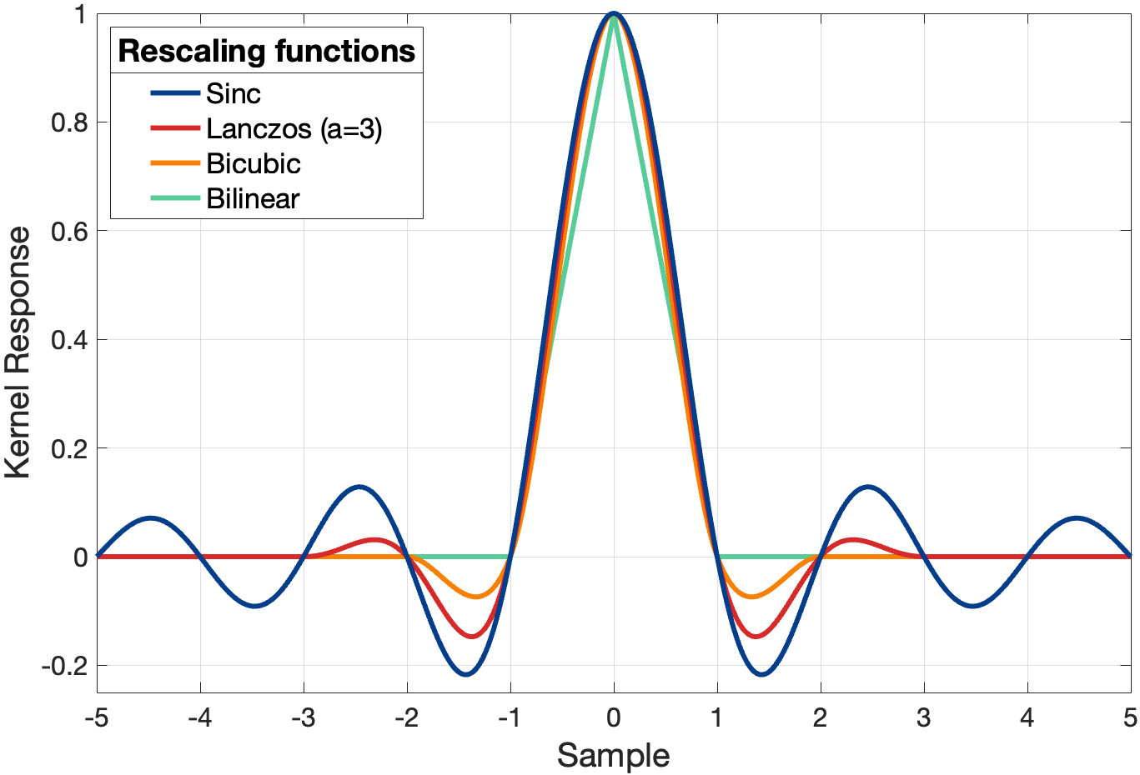
Rescaling-based quality metrics

Slide 13
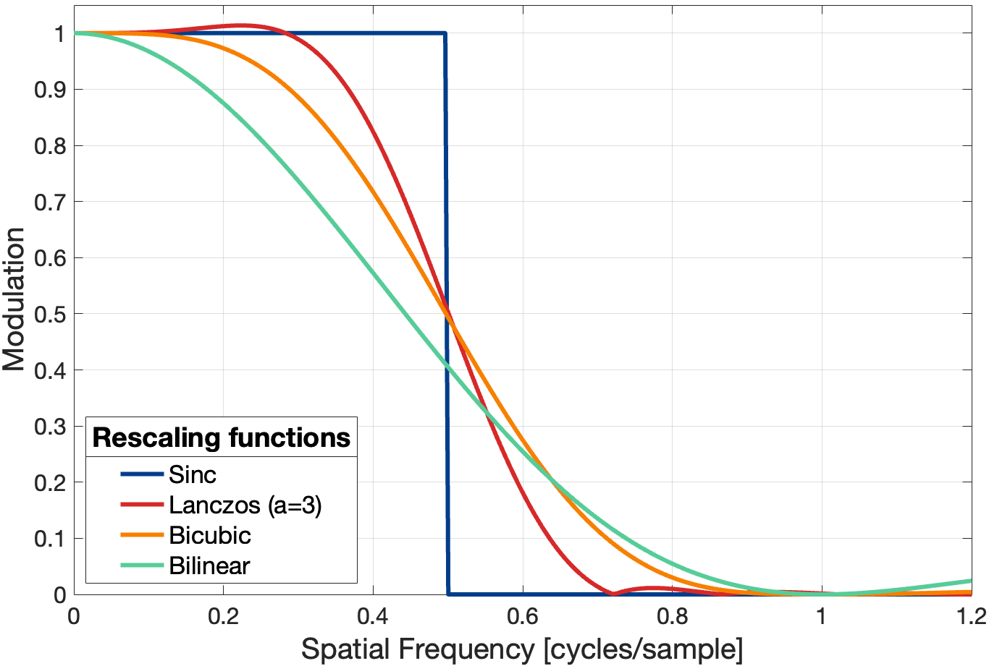
Rescaling-based quality metrics

Slide 14
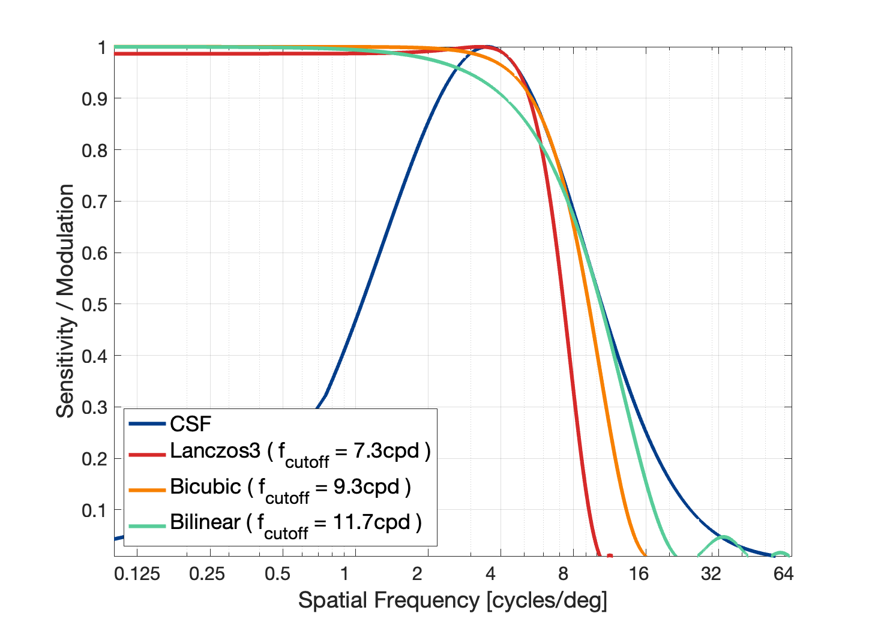
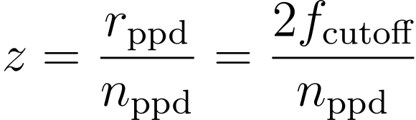
CSF and Rescaling filters - Comparison
A rescaling function is a low-pass filter that resembles the right portion of the CSF.
If we can find the right cut-off frequency, we can make the rescaling function closely approximate the CSF in its behaviour.
Hence, given this cut-off frequency, we can define the rescaling factor as:

Slide 15

Comparison analysis in the frequency domain
It is essential to understand the behaviour of both the contrast sensitivity and rescaling functions when predicting the visibility of the images’ distortions at each effective resolution.
We compute the power spectrum of seven different distortions.
White Gaussian Noise
Gaussian Blur
JPEG
JPEG2000
Lanczos3 resampling
Adaptive scalable texture compression (ASTC)
Display non-uniformity

Slide 16



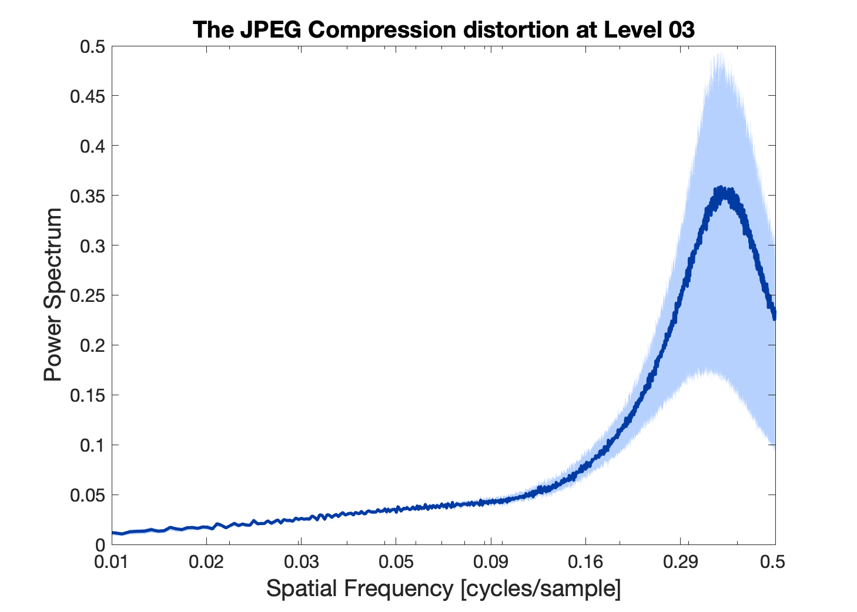
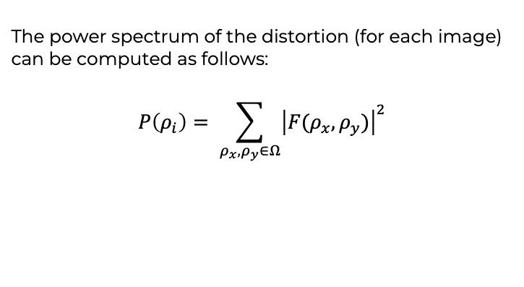
Power Spectrum of “Distortions”
To compute the power spectrum of the distortions, we select 40 images from the DIV2K dataset [1], each degraded by seven distortions in five levels.
For each pair of reference and distorted Image, we calculate the difference, and use it as a representation of the distortion.
The power spectrum of the distortion (for each image) can be computed as follows:
$$P\left(ρ_{i}\right)= \sum_{ρ_{x}, ρ_{y}∈Ω}{{\left|F(ρ_{x}, ρ_{y})\right|}^{2}}$$
[1] Agustsson, E., & Timofte, R. (2017). Ntire 2017 challenge on single image super-resolution: Dataset and study. In Proceedings of the IEEE conference on computer vision and pattern recognition workshops (pp. 126-135).

Slide 17
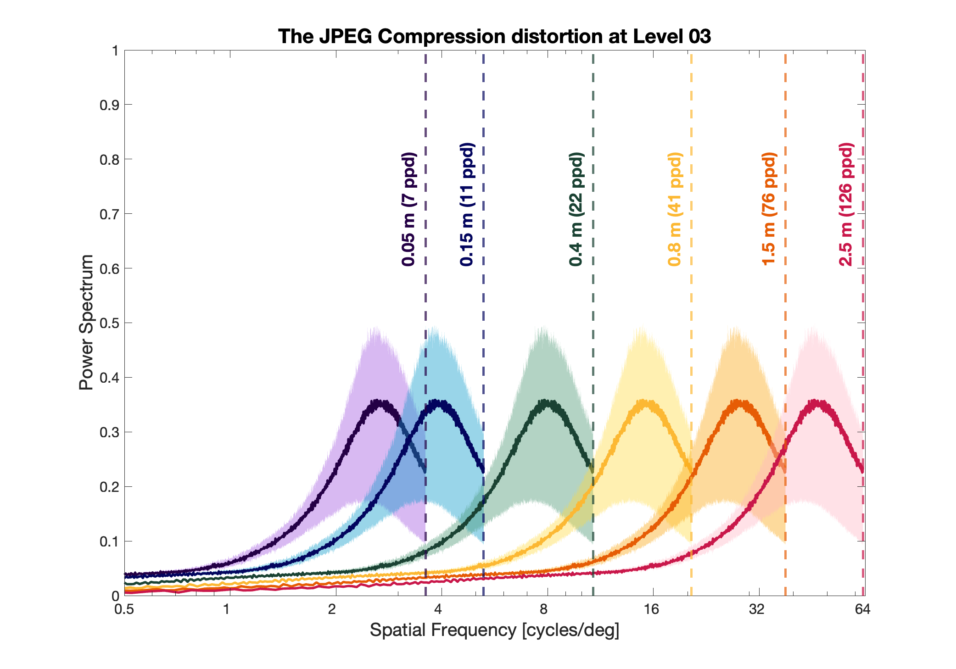
Comparison analysis in the frequency domain

Slide 18
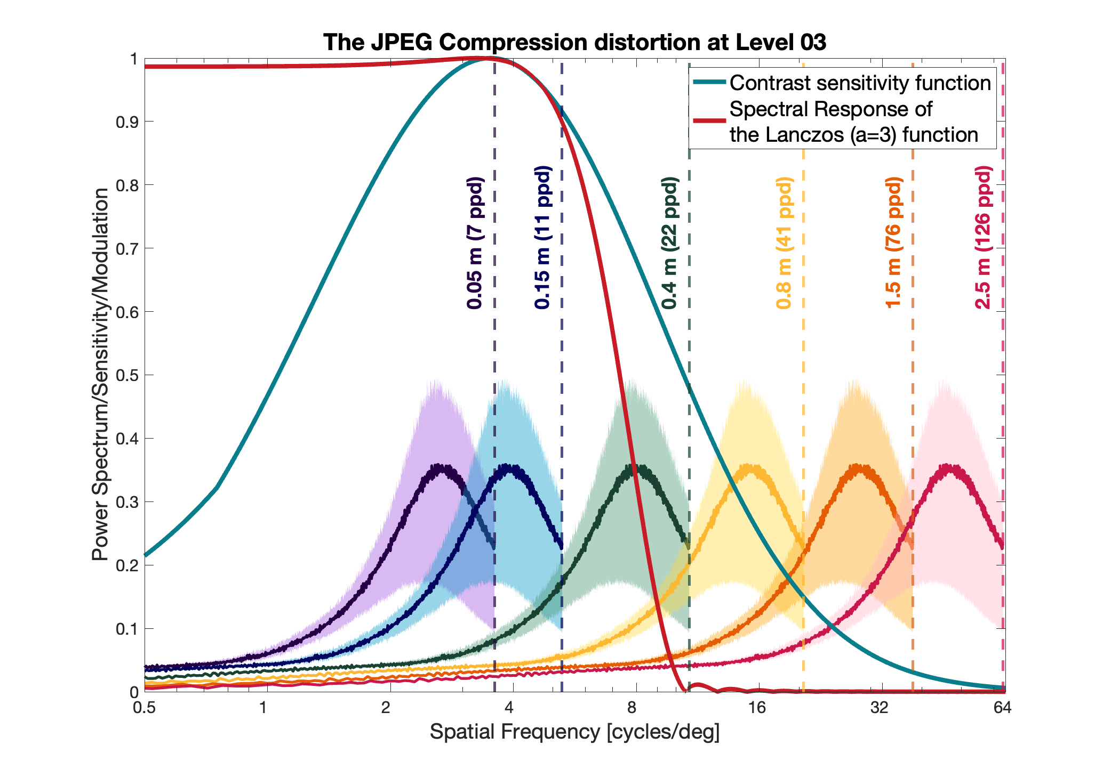
Comparison analysis in the frequency domain

Slide 19
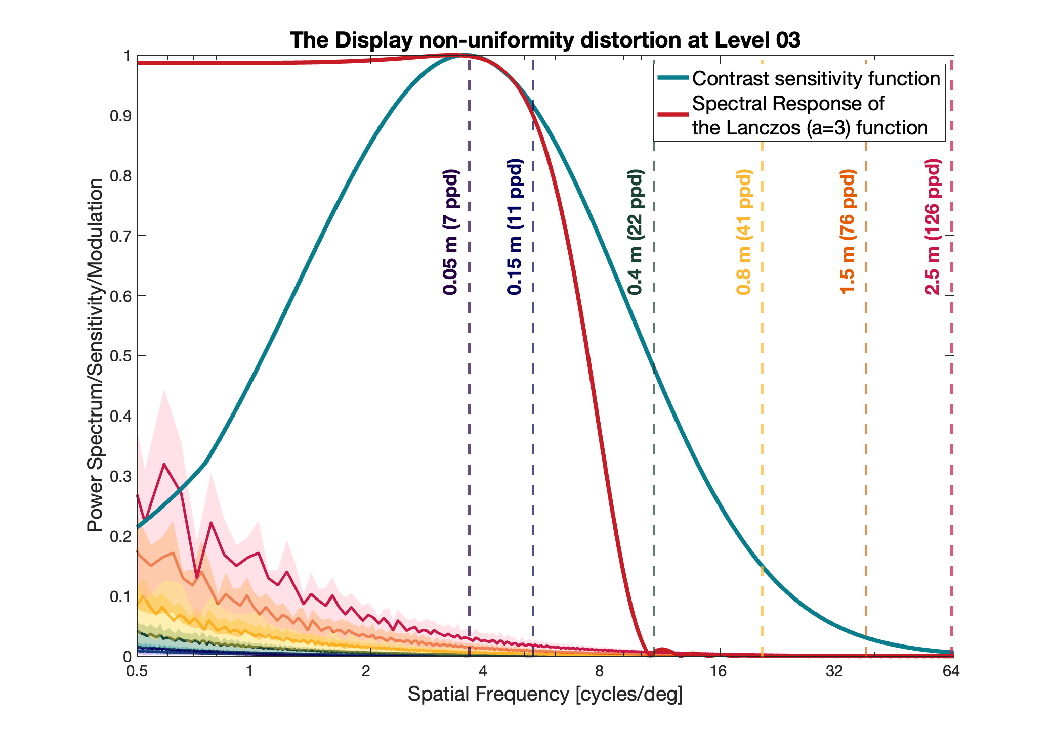
Comparison analysis in the frequency domain

Slide 20
Comparison analysis of metric’s predictions
To validate our findings, we analyse the predictions of the two types of filtering approaches using the PSNR metric.
Why PSNR?
Because it’s a pixel-based metric, it will allow us to better comprehend the effect of both filters independently from the effect of the quality metrics itself.

Slide 21
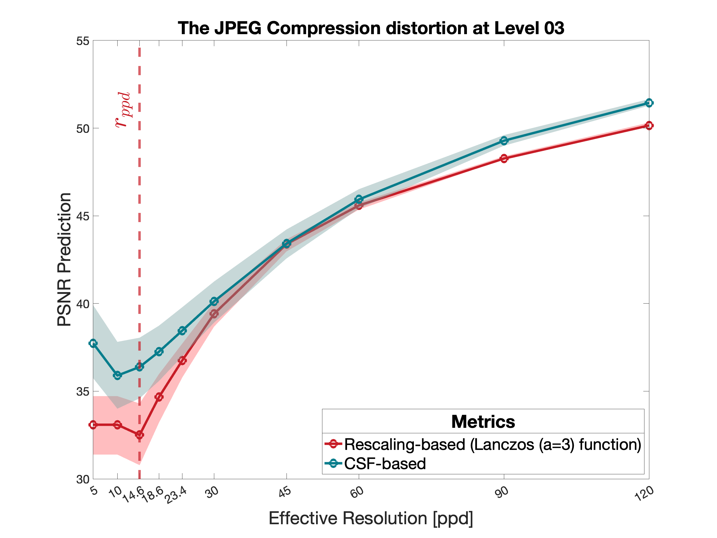
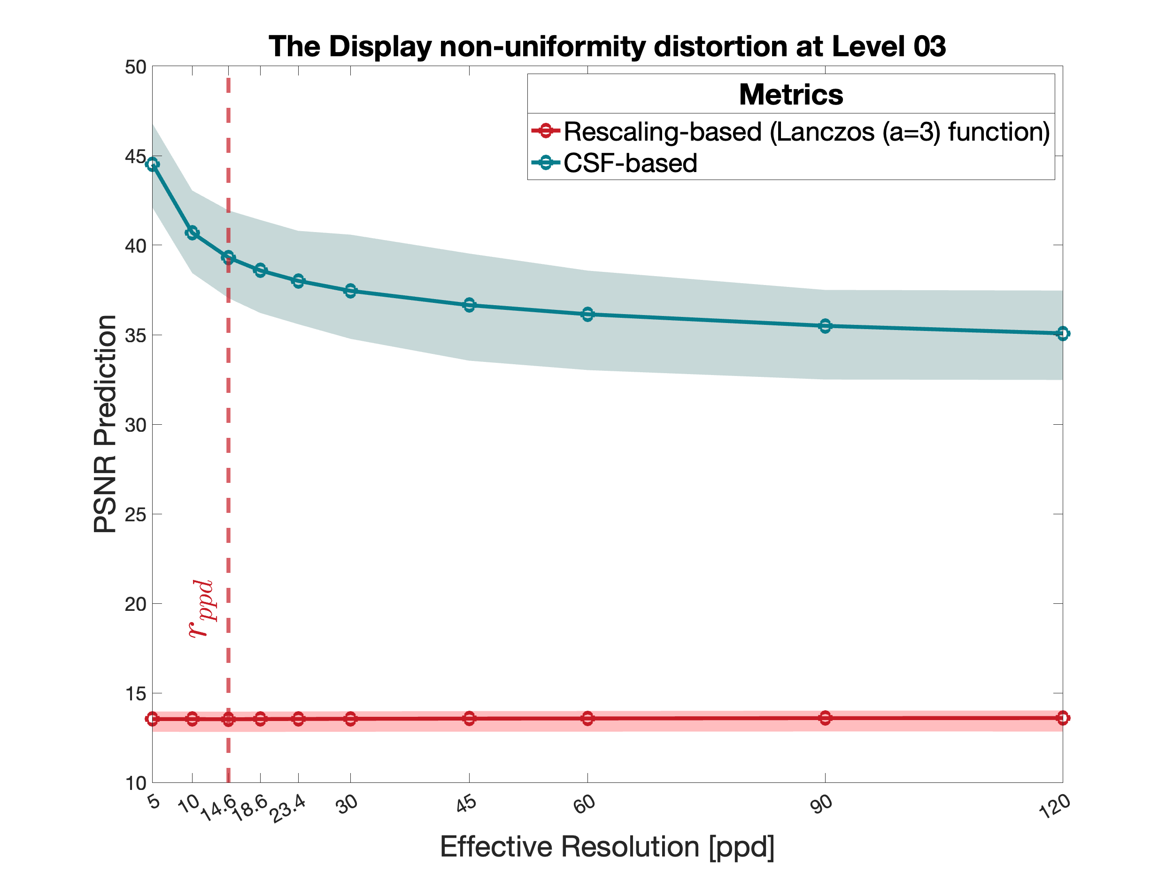
Comparison analysis of metric’s predictions

Slide 22
Conclusion
We investigated the differences and similarities between CSF and rescaling-based quality metrics.
We proposed a rescaling factor to match the rescaling functions to the CSF.
We found that rescaling functions can approximate the CSF function, for large viewing distances and high-frequencies distortions.

Slide 23
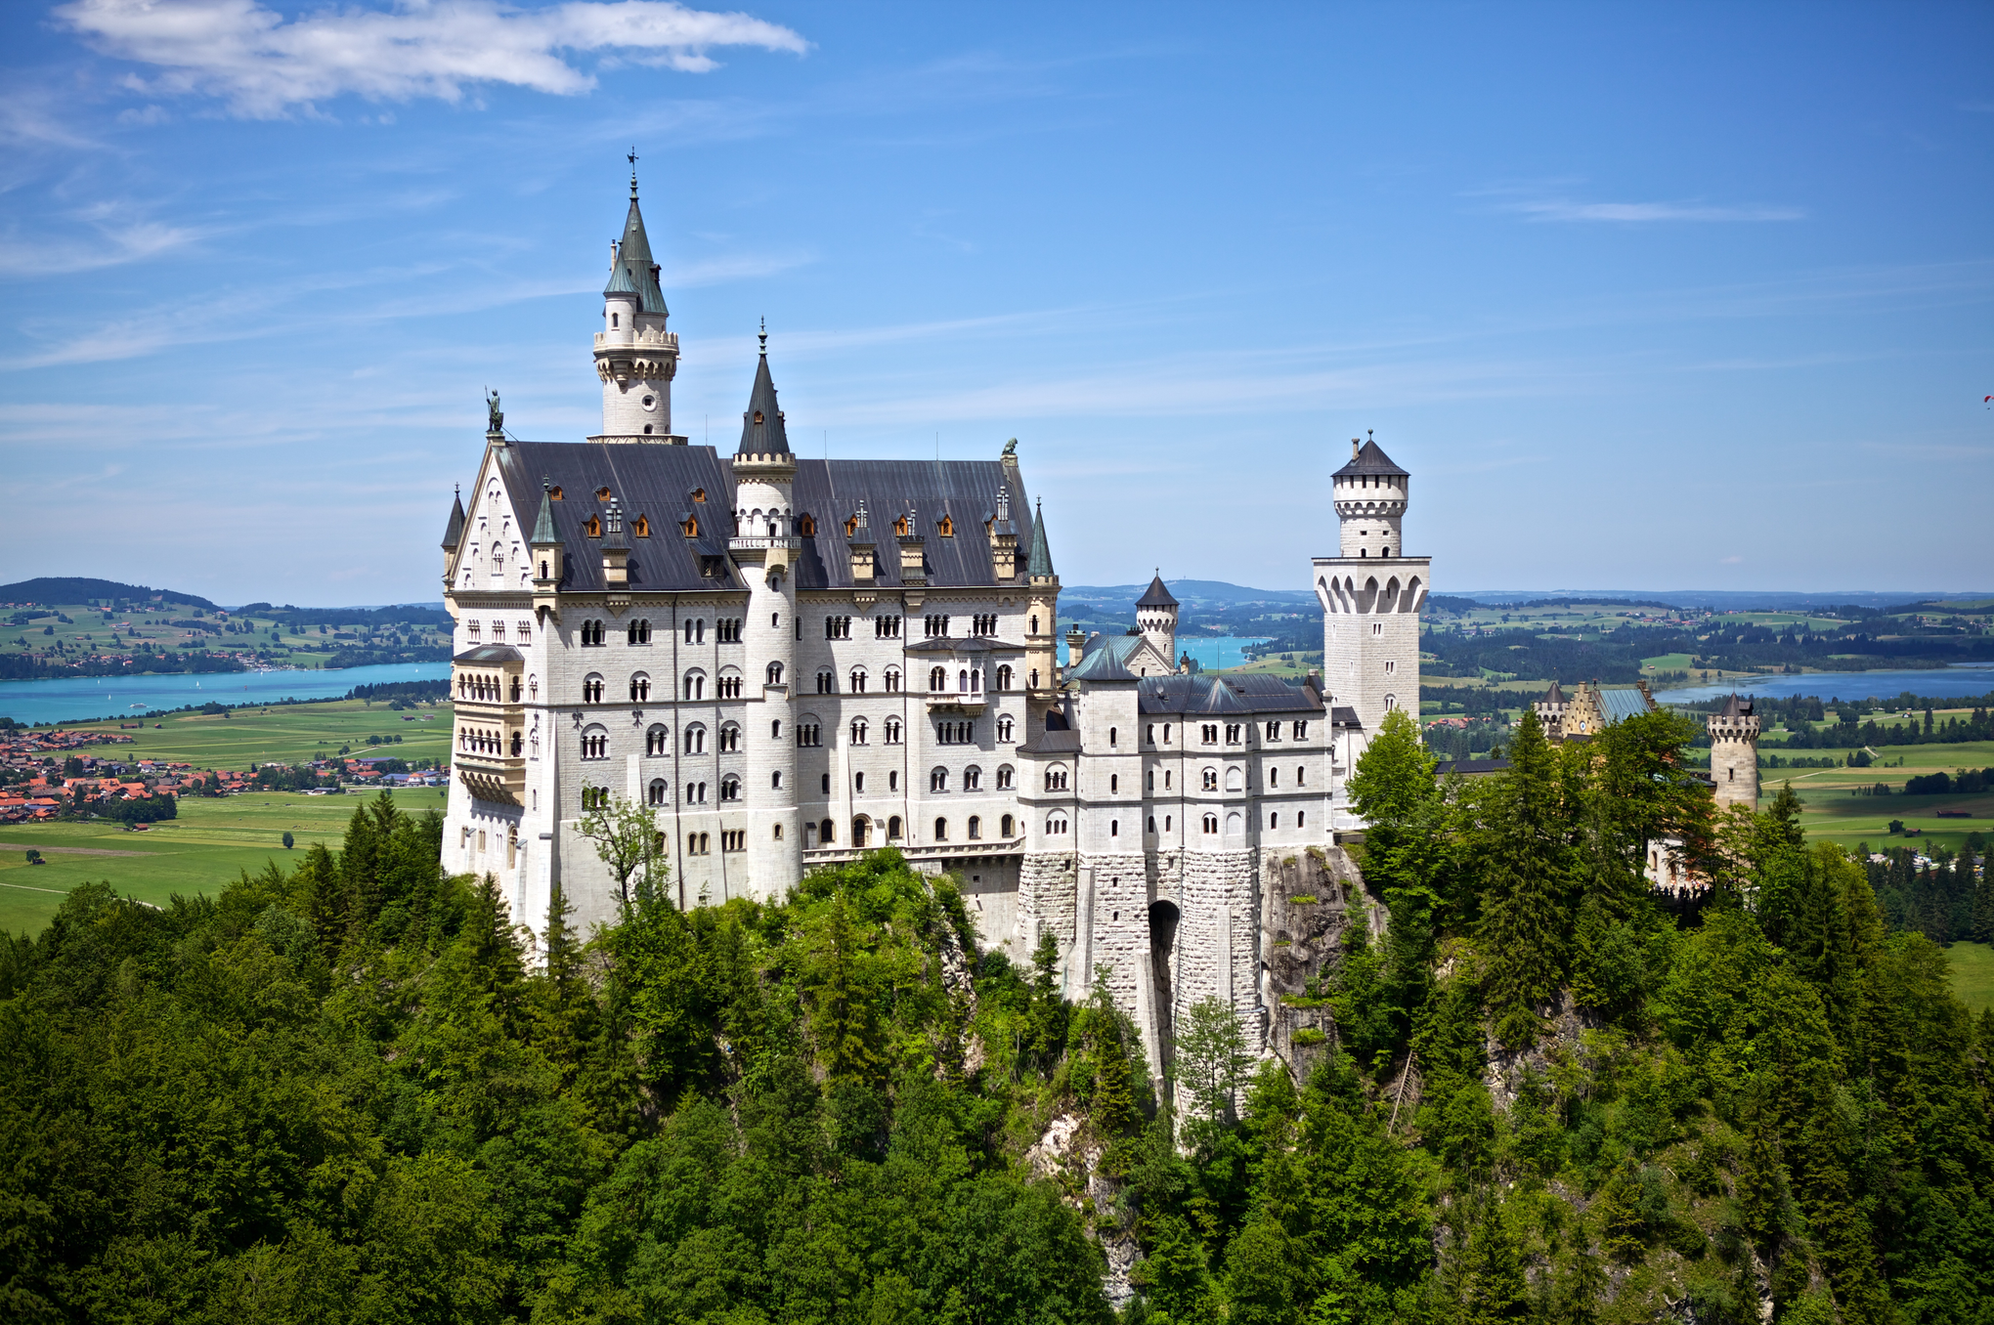


Thank you Any Question?
23

